Slide 1
Effects
USING DIGITAL SIGNAL PROCESSING TO GENERATE EFFECTS ON A HARDWARE IMPLEMENTATION

Slide 2
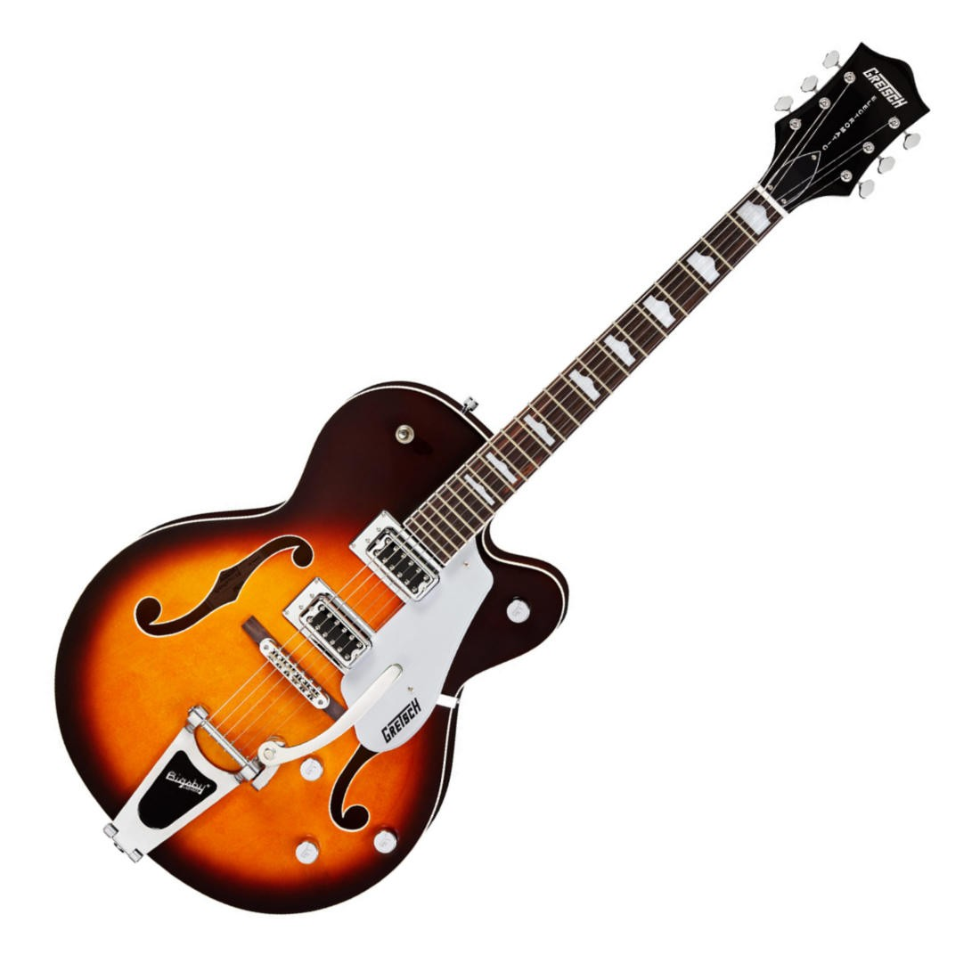
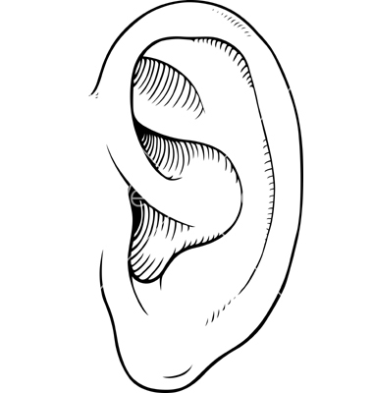
Infrastructure
XADC
EFFECT 1
MUX
(EFFECT SELECTION)
FIFO + PWM
EFFECT 2

Slide 3
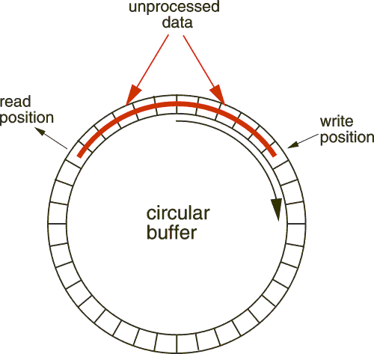
Circular Buffer – Base of many effects

Slide 4
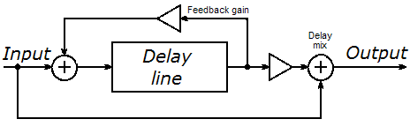
Delay and Echoe
Y=[n] = a*x[n + t] + b*x[n]

Slide 5
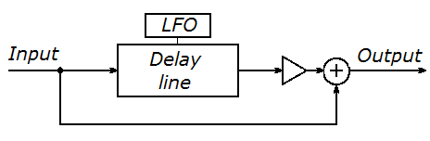
Chorus
Ychorus[n] = x[n + T(t)] + x[n]
T(t) = Asin(w) [w = rad/s]

Slide 6
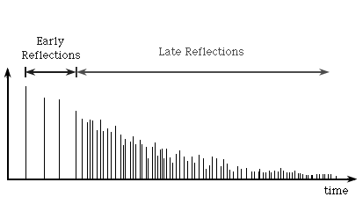
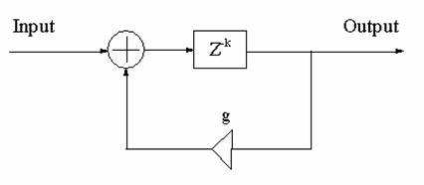
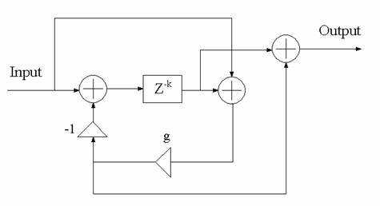
Reverb
Late Reflections
Allpass Reveberator, which generates non-constant reflections

